Slide 1
Approaches to Learning
Assignment 2 – Reflective Portfolio; Report and Appendices
Due Wed April 28th 9pm

Slide 2


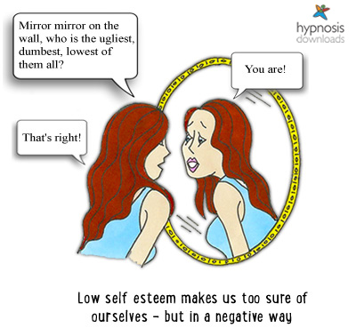
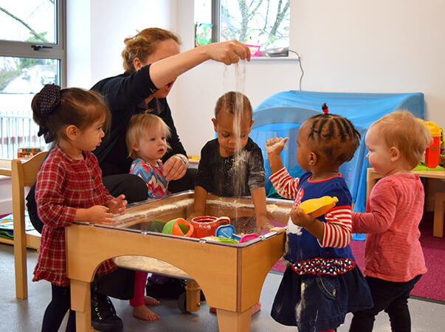

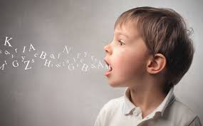
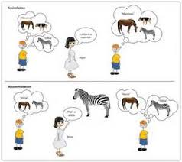


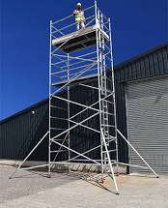
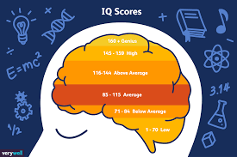
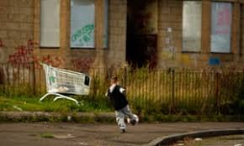

Approaches to Learning

Slide 3
Last teaching weeks
Last Weeks:
Week 22
Fri 19th March – Submit Draft of first section of report
Tuesday 16th – Lecture/seminars Critical Thinking
Week 23
Tuesday 23rd March – Tutor feedback on drafts and Q&A
Mon 29th March - Fri 9th April – Easter Break
Week 24
Tuesday 13th April –Employability & Assignment Support;
Wednesday 28th April – MDX Deadline

Slide 4
Assignment 2: Reflective Report
Demonstrate understanding of key approaches to learning by applying a selection to self and to educational settings

Slide 5
Aim of the Assignment
The aim of this assignment is to meet the Learning Objectives for the Module;
Examine and explore ways that people learn (LO4) (e.g. Bandura, Piaget, Vygotsky) and how this has informed pedagogies.
Evaluate factors contributing to cognitive development (LO1) (e.g. Language, Intelligence, Special Needs, Self-efficacy)
Explore how broader social influences can impact on a child’s educational experiences and achievement (LO3) (Bronfenbrenner, Early Years Settings and Schools, SEND Support, Disadvantage, Gender, Ethnicity)
Demonstrate skills of self-reflection (LO5) on own learning, personal & professional experiences (through Tasks & Report)

Slide 6
Assignment Objective
Produce a Reflective Report applying theories learned within the module and based on the completion of 10 Tasks outlined in the 1202 Workbook.
The report should have a Title Page, a Contents Page, Subheadings, An Appendix (of 10 completed, corrected tasks) and a Bibliography (which can include the references used for the tasks themselves).

Slide 7
Title Page
Demonstrate understanding of key approaches to learning by applying a selection to self, and to educational settings.
Seminar Tutor Name:
Student Name/Number
Date

Slide 8
Example - Contents Page
Introduction p. 2
Theme 1 p. 2
Theme 2 p. 3
Conclusion p. 4
Bibliography p. 5
Appendices p. 6-20 (Includes 10 completed tasks)

Slide 9
Introduction
The introduction to the report suggests the aim of the report and signposts the topics to be covered

Slide 10
Example content for introduction (100 words)
What are ‘approaches to learning’ and what is ‘reflection’? (Lecture 2) Why are these important…
E.g. For development of academic self, personal self and professional self?
E.g. For application to future work with children and young people in settings

Slide 11
Example Introduction (Approx. 100 words)
This module, ‘Approaches to Learning’ has encouraged me to consider a number of topics;………….. Studying about topics such as.......is important because it helps us to understand…. I feel that I have learned most from studying the topic………I especially enjoyed learning that….
The module has also required us to reflect on our learning in this module and how the topics relate to our academic self, personal self and professional self . Reflection means….This is important because…….I feel that I have particularly developed my knowledge and skills in the areas of………..(See Appendix 5 page 12 where I have outlined my strengths and weaknesses within a SWOT analysis)
This development will be particularly important to me in that………… (100 words)
The two themes to be considered in this reflective report are…..&….

Slide 12
MAIN BODY: Consider theories studied this term. Choose TWO themes from the following that you feel have helped you to understand better; your personal, academic and future professional life: (600 + 600 words)
Constructing our knowledge of the world; Constructivism - Consider ways that you, within an early years setting or school could employ Piaget’s and Vygotsky’s theories. Discuss possible practical problems in implementing the theories (Tasks 4 & 5)
Personal attributes; Discuss your own self-esteem, self-efficacy and self-regulation, multiple & emotional intelligences, and how quality educational settings nurture some of these in children (Task 6, 8 & 10a)
Communication; Consider ways that you have been supported in terms of your language & literacy (including SEND or EAL experiences), and how you could support children effectively in terms of language & literacy development (including those with SEND or EAL) (Task 9 & 10a)
Social Influences; Consider how children’s education is (and your own has been) affected by wider social influences such as wealth & poverty, gender and/or ethnicity (Refer to Bronfenbrenner’s Macrosystem and statistical evidence) (Task 6, 7 & 10b)

Slide 13
How to tackle each chosen theme……….

Slide 14
Theme 1 – Constructing our knowledge of the world; Constructivism - Consider ways that you, within an early years setting or school, could employ Piaget’s and Vygotsky’s theories. Discuss possible practical problems in implementing the theories (Tasks 4 & 5) (Lecture 8, 9 & 16)
…The constructivist and social constructivist theorists suggest that children’s cognitive development occurs in particular ways. Two such theorists are Piaget and Vygotsky. They have both influenced early years and primary education. I will describe the theories and give examples of how I have/will refer to these theories in my work with children….(50 words)
Describe Piaget’s theory; stages, schema, assimilation, and accommodation, ‘Little Scientists’? Identify one criticism of this theory. Applying the theory; How would knowledge of Piaget’s theory guide your experience working with young children? (e.g. through an enabling environment) What possible practical problems might arise in implementing this theory e.g. with children with SEND? (300 words).
Describe Vygotsky’s theory and describe how children learn through ‘Cultural Tools’ (such as language). Explain the ZPD. Applying the Theory: Explain with examples how you have/would ‘scaffold children through their ZPD’. What possible practical problems might arise in implementing this theory in an early years setting or school? (300 words).

Slide 15
Theme 2 - Personal attributes; Discuss your own self-esteem, self-efficacy and self-regulation, multiple & emotional intelligences, and how quality educational settings nurture these in children (Task 6, 8 & 10a) (Lectures 11 - 15)
…Self-esteem, efficacy and regulation, multiple and emotional intelligences have been shown to be hugely significant in the education and lives of children, not least of all children with special needs. I am also aware of how they have influenced my life, and will consider how I might use my understanding in work with children…(50 words)
Define/describe self-esteem, self-efficacy and self-regulation, multiple and emotional intelligences . Apply: Give examples of your strengths and weaknesses in some of these areas. (150 words)
Applying the theory to show how, when working in a quality early years setting or school, you could help children (including those with SEND or EAL) to develop some of these attributes e.g. through varied activities, scaffolded learning (Vygotsky) , and effective role models & positive reinforcement (e.g. refer to Bandura’s Social Cognitive Theory) (300 words). What practical problems may arise.

Slide 16
Theme 3 -Communication; Consider ways that you have been supported in terms of your language & literacy (including SEND or EAL experiences), and how you could support children effectively in terms of language & literacy development. (including those with SEND or EAL) (Task 9 & 10a) (Lecture 14 & 16 & 1203 Lectures)
…Communication & Language development are hugely important to children’s overall development & achievement. I have identified strengths and limitations in my own oral and written skills. I can also reflect on how I developed the skills of being a bilingual. Together with theories and strategies of language and literacy, I can suggest ways of supporting children in my care….
Define what is meant by language and literacy development. Define bilingualism (and numbers of children with EAL), and/or numbers of children with SEND (Communication difficulties) (100 words)
Apply: Consider your strengths and weaknesses in terms of oral and written language skills, and ways you have been supported (including SEND or EAL experiences), and the impact of these, on your life (personal, academic and professional) (150 words).
Describe a related theory or research regarding language acquisition (Chomsky, Vygotsky), bilingualism, or laws, policies regarding the rights of children with SEND (200 words).
Apply: Suggest a way that you have/could support a child who has English as a Second Language, or a specific communication need – refer to a specific activity, and your role in supporting the child (Vygotsky) (150 words)

Slide 17
Theme 4 - Social Influences; Consider how children’s education is (and your own has been) affected by wider social influences such as wealth & poverty, gender and/or ethnicity (Refer to Bronfenbrenner’s Macrosystem and statistical evidence) (Task 6, 7 & 10b) (Lecture 1, 19 & 20)
…Children’s education can be hugely influenced by wider social influences such as wealth/poverty, gender and ethnicity. Bronfenbrenner’s theory shows this. I have considered how these may have affected my personal, academic and professional life, and how settings can remain inclusive…(50 words)
Describe Bronfenbrenner’s model to show the influence of wider social influences on children’s education. (100 words)
Describe how one or more of the factors (poverty, gender or ethnicity) can affect a child’s educational achievement (Statistics). (200 words) (Self-esteem/self-fulfilling prophecy, Bandura – role models)
Apply: State how one or more of the factors (poverty, gender or ethnicity) has affected your educational experiences. (150 words)
Apply: How can early years settings and schools remain inclusive in regards to all children? (150 words). What may be some practical problems in trying to achieve this?

Slide 18
Demonstrate critical thinking
Remember to compare, contrast and criticise ideas where possible by using appropriate linking words…however…therefore…in comparison with…in contrast to…has the advantage/ disadvantage of…a criticism of the theory/research is….)

Slide 19
Report Conclusion
From what you have discussed, conclude with what you consider has been your greatest learning in the module this year and how this will inform what you do next in your personal, academic and professional life.

Slide 20
Example Conclusion (100 words)
On reflection of the module and on completing this report, I fell that I have learned much about the topic of……, especially……….. Looking forward, I fell that I would like to learn more about………
I have also learned about myself in terms of…….Looking forward I feel I can develop in certain areas. For example, in terms of my personal skills…….In terms of my academic skills………..For my future professional development, I will concentrate on developing…………...

Slide 21
Bibliography
AT LEAST 6 ACADEMIC References (Each themes should contain a minimum of 1 or 2 references)
Not McLeod, ‘Simply Psychology’
Use the Koretext and references listed for your tasks
http://www.citethemrightonline.com

Slide 22
Harvard Referencing
Single Author
Recent research indicates that the number of duplicate papers being published is increasing (Errami, 2008).
Multiple Authors
Evidence shows that providing virtual laboratory exercises as well as practical laboratory experience enhances the learning process (Barros, Read & Verdejo, 2008, OR, Barros et al, 2008).
Cited-in Format
Fong’s 1987 study (cited in Bertram 1996) found that older students’ memory can be as good as that of young people, but this depends on how memory is tested.
(In Bibliography; Bertram, F 1997, The tragedy of youth, 2nd edn, Macmillan, New York.)
When citing work from a book that has been ‘edited’, the author who wrote the chapter should be cited, not the editor of the book.,

Slide 23
No obvious author;
A national strategy is creating a framework to drive improvements in dementia services (Department of Health, 2009)
No obvious date (websites)
(Bland, n.d.)

Slide 24
Direct quotes
Simons, Menzies and Matthews (2001) state that the principle of effective stress is ‘imperfectly known and understood by many practising engineers’ (p.4)
Longer quotes
A recent UK report summarised the importance of mathematics to society and the knowledge economy, stating that:
Indented ‘Mathematics provides a powerful universal language and intellectual toolkit for abstraction, generalization and synthesis. It is the language of science and technology. It enables us to probe the natural universe and to develop new technologies that have helped us control and master our environment.’ (Smith, 2004: p.11)

Slide 25
Bibliography
Barros, B., Read, T. & Verdejo, M. F. (2008) Virtual collaborative experimentation: an approach combining remote and local labs.
IEEE Transactions on Education. 51 (2), 242–250.
Bertram, F 1997, The tragedy of youth, 2nd edn, Macmillan, New York.
Department of Health. (2009) Living well with dementia: a national dementia strategy. Available from: www.gov.uk/government/publications/living-well-with-dementia-a-national-dementia-strategy [Accessed 4th June 2015].
Errami, M. & Garner, H. (2008) A tale of two citations. Nature. 451 (7177), 397–399.

Slide 26
Appendix
Include 10 completed and corrected/proof-read, reflective and referenced entries from the reflective portfolio.
You can reference these from the report (e.g. See Appendix, Task 6)

Slide 27
Level Descriptors for essay and report
Section | 1-4 | 5-8 | 9-12 | 13-16 | 17-20
Knowledge & Understanding of Topic: Content chosen relevant and informative, with a depth of knowledge and understanding | Excellent and well informed understanding of theories and concepts involved with topic | Good understanding of theories and concepts involved with topic | Demonstrate satisfactory knowledge and understanding of topics theories and concepts | Adequate content, and limited depth of knowledge and understanding | Inadequate content and limited depth of knowledge and understanding
Cognitive Skills: Logical development and analysis of information: Topics supported by examples, to the required level of detail | Offers a tightly structured, logical and cogent argument with good integration between theories and concepts. | Undertakes a systematic debate of the issues with some integration between theories and concepts | Observable structure with appropriate application of theory | Structure is loose with theory presented separately though essay title still addressed. | Lack of logical development of concepts and theories.
Reading and References: Reference to sources including directions for further study | Broad and relevant readings examined and used selectively and effectively | Good range of appropriate references used effectively | Conventional (6) references and readings used effectively | Adequate range but limited effective use of references | Critique relies on limited, non-academic, or no references; and unexamined personal opinion
Presentation: Communication: interesting, relevant language; explanation of terminology; clear and concise; | Communication: Very well expressed | Communication: Very well expressed; minor errors | Communication: Generally well expressed; some errors but not enough to obscure meaning | Communication: Unclear expression at times; errors sometimes obscure meaning | Communication: Unclear and confusing

Slide 28
Seminar Activity 1
In breakout groups, look at the guide structure given for one of the topics (Slides 14-17 in today’s lecture). Read & allocate the tasks below to each member of your group. Discuss what each person needs to be researching. Spend up to 30 minutes to find your information;
From the relevant lectures related to your chosen topic, find 4 points of relevant information; e.g. definitions, statistics, policies to share with the group
Identify page numbers in the Koretext which address 4 terms presented in the guide structure.
Find 2 books or journals on the Library Search which address supporting children in early years or schools e.g. with their;
    a) cognitive development,
    b) emotional development,
    c) language/literacy development (and, children with SEND, or Bilingual children)
    d) Children from different cultural backgrounds
Find on Google Books, two books which broadly address the theories relevant to the topic in the guide structure.
Share findings with your group. How easy or difficult was it to find the info? How useful do you think the sources will be to your assignment?

Slide 29
Seminar Activity 2 - Introduction
In the full group, complete these sentences & share to help structure your introduction;
In this module, we have had to reflect by applying theories to our own personal, academic and professional selves. Reflection is important because…….
I feel that I have gained most knowledge from this module from studying the topics………
The skills I have mostly developed in this module are……..
This development will be particularly important to me in future for…………
The two themes to be considered in this reflective report are…..&….
Q&A
Hand in a draft Fri 19th March
Tutor to allocate a time (this week or next for a 1:1 tutorial in Week 23/24.

